Slide 1
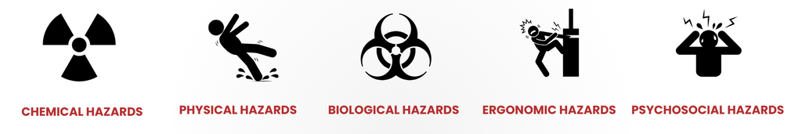
introduction TO INDUSTRIAL HYGIENE
From Principles to Practice

Slide 2
Disclaimer:
TOSHA believes the information provided in this presentation to be accurate and offers it as a public service. However, this is an academic and informational overview that may not address every specific fact or circumstance. It is not a substitute for the requirements outlined in 29 CFR Part 1910 and/or Part 1926 of the Occupational Safety and Health Standards, as adopted by the Tennessee Department of Labor and Workforce Development, or for the Occupational Safety and Health Rules of the Tennessee Department of Labor and Workforce Development.
Important Notice:
This training is not intended to replace required initial or annual safety and health training. Employers are responsible for ensuring that site-specific training is conducted in accordance with applicable regulations.

Slide 3



WHAT IS INDUSTRIAL HYGIENE?
They sniff danger for a living. Metaphorically.
An OSHA Industrial Hygienist is basically the person whose job it is to walk into a workplace and figure out all the invisible, silent, tasteless ways it might kill or maim you. They're the science nerds of workplace safety—the people who know what benzene smells like before your blood does.
Here’s what they actually do, in case you're trying to impress someone or trick your way into sounding smart:
Identify health hazards: They detect chemical, biological, physical, and ergonomic hazards. If there's something in the air, the water, or lurking inside that poorly labeled drum in the corner, they know about it.
Evaluate exposure: They use instruments and tests to see how much exposure workers are getting. Translation: they get real cozy with things like air sampling pumps and noise dosimeters.
Recommend controls: They suggest how to not die. This includes ventilation systems, personal protective equipment (PPE), or fixing work practices that make everyone walk around like hunched-over goblins.
Enforce standards: If you think you can just slap a bandana on your face and handle asbestos, they’re the ones who will show up and say, “No, Jeff, that’s not how lungs work.”
Educate and train: They teach people how not to poison themselves or others at work. Basically, adult babysitting with PowerPoint.
So yeah, they’re like workplace detectives, but instead of chasing criminals, they chase airborne particulates and improperly stored solvents. And yet people still don’t invite them to parties. Weird.

Slide 4
OBJECTIVES
An overview of industrial hygiene and hazards addressed
Recognize some common workplace health hazards
Methods of hazard assessment and control
Application of industrial hygiene to TOSHA standards

Slide 5
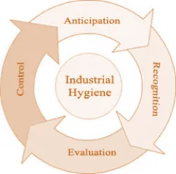
INDUSTRIAL HYGIENE PRINCIPLES
Anticipation
  Foreseeing potential health and safety hazards.
  Look at the process – How is something made?
Recognition
  Identifying existing health and safety hazards in the workplace.
  Observe the processes, such as grinding or welding, tool(s), and/or chemicals.
Evaluation
  Measuring and quantifying the extent of worker exposure to identified hazards using environmental monitoring and analytical methods.
Control
  Applying a hierarchy of controls to eliminate or reduce hazards

Slide 6
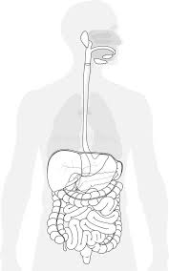
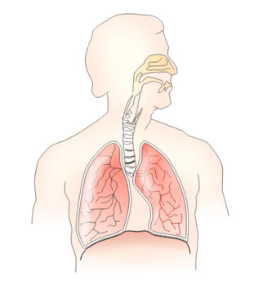


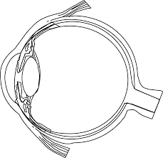
ROUTES OF ENTRY
Inhalation
  Absorption of hazardous chemicals via the respiratory tract (lungs).
Ingestion
  Absorption of hazardous chemicals through the digestive tract (mouth, stomach, intestines).
Injection
  Absorption of hazardous chemicals directly into the bloodstream.
    e.g. broken glass, plastic, pipettes, needles, razor blades, etc.
Eye and Skin Absorption
  Absorbed by the eyes and skin from a chemical spill or splash to unprotected eyes or skin.
    Skin notation

Slide 7
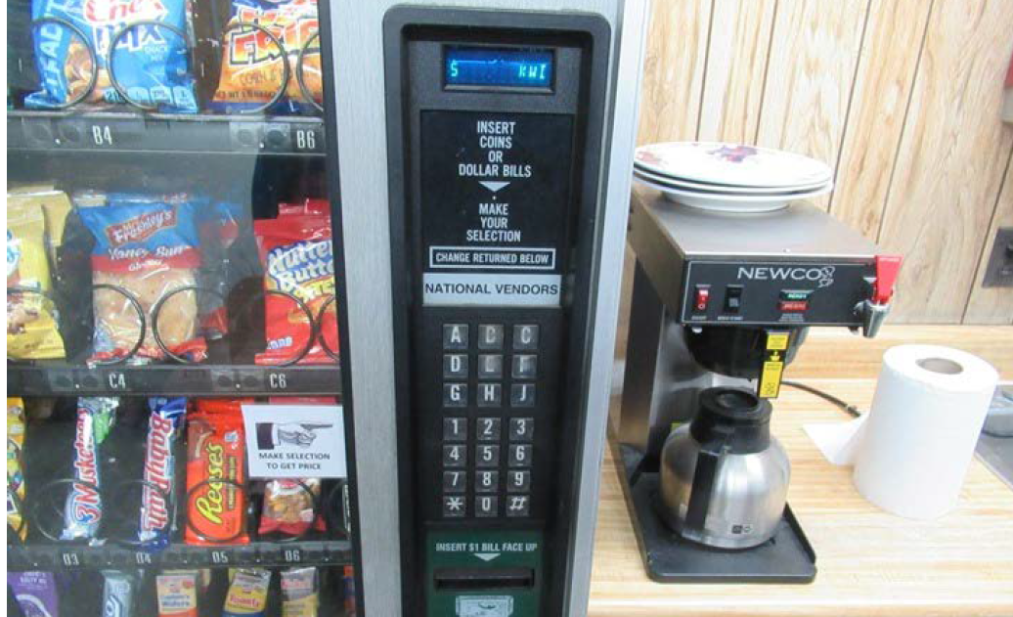
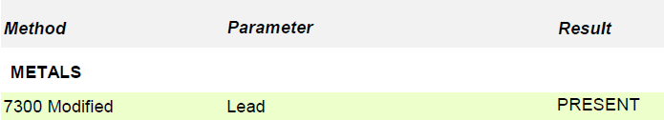
ROUTES OF ENTRY
What routes of entry could the employees be exposed to in this picture?

Slide 8
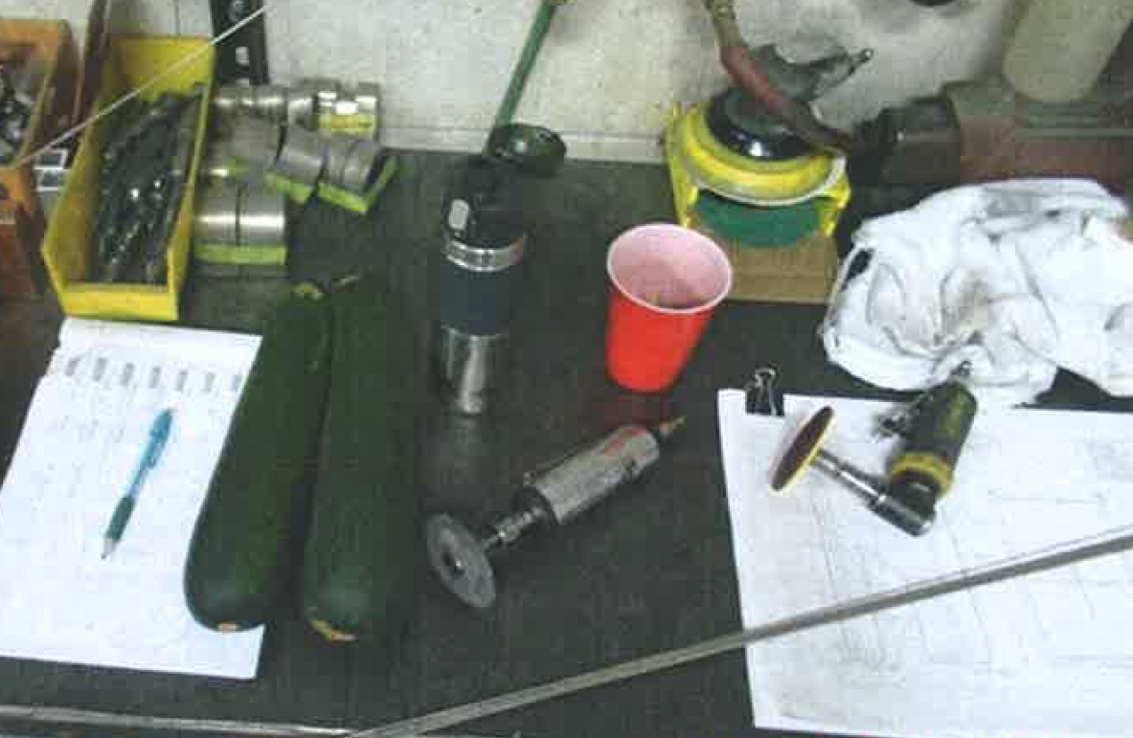
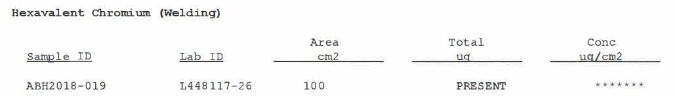
INGESTION fresh vegetables for a coworker

Slide 9
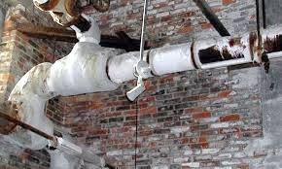
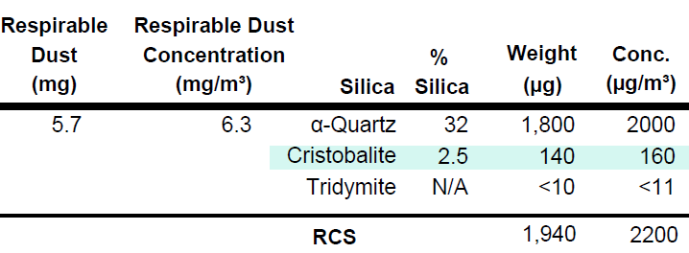
INHALATION
Dusts
  Airborne solid particles
    e.g. Silica, lead, asbestos, combustible, plastic, etc.
Fumes
  Solid particles resulting from the condensation react with air to form an oxide.
Gases/Vapors
  Gases - Formless fluids that expand to occupy the space or enclosure in which they are confined.
  Vapors - Volatile form of substances that are normally in a solid or liquid state at room temperature and pressure. Vapors are gases in that true vapors are atomic or molecular in nature.
Mists/Aerosols
  Mists – Liquid suspended in the atmosphere
  Aerosols - Form of a mist characterized by highly respirable, minute liquid particles.

Slide 10
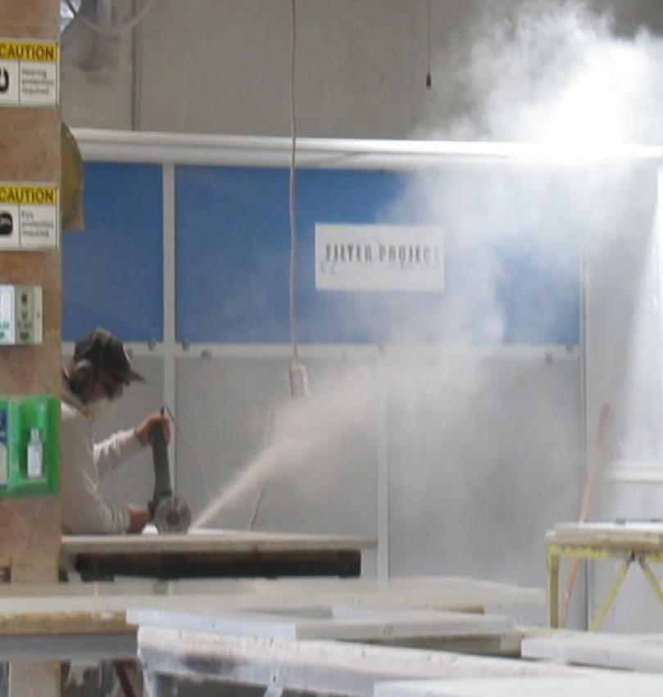

DUSTS VS. FUMES
Notes:
Dust Dust consists of fine, dry particles that are already in a solid state. It can come from everyday sources such as soil, pollen, hair, or even industrial materials when bulk solids are broken down into smaller fragments. Dust is often generated by mechanical processes like abrasion or the natural shedding of materials—think of the powdery residue you see on a shelf or the fine particles stirred up during a cleaning. Despite its innocuous appearance in some cases, certain types of dust (for example, combustible or silica dust) can pose serious health or safety risks in workplaces if not properly managed .
Fume Fumes, on the other hand, are produced when a substance—usually a metal or a chemical—is heated to the point of vaporization and then quickly cools, condensing into tiny solid particles suspended in the air. This process is common in activities such as welding or soldering, where the material changes phase before forming an aerosol of ultra-fine particles. Because these particles are often sub-micron in size, they can be inhaled deeply into the lungs and may carry toxic or irritating compounds. This is why processes generating fumes require specialized ventilation and personal protective equipment (PPE) like full-face respirators, unlike typical dust which might be managed by simpler measures 2.
Why the Distinction Matters Understanding this distinction is especially critical in environments where worker safety is a concern. Dust management often involves controlling the dispersion of particles through air filtration and surface cleaning, while fume control requires more robust measures such as local exhaust ventilation and higher-grade respiratory protection because of the smaller particle size and chemical nature of the materials involved. Using the right terminology ensures that safety protocols are appropriately designed, helping prevent exposure to potentially hazardous airborne substances .

Slide 11
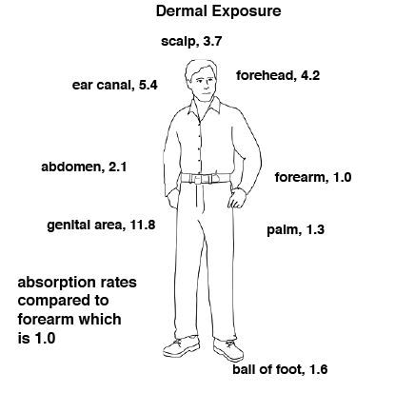
SKIN ABSORPTION

Slide 12

ABSORPTION
TN SPECIFIC LAWS
“Skin designation” for hazardous chemicals
  0800-01-01
    Occupational Safety and Health Standards for General Industry
    TABLE Z-1-A (pg. 8)
  X = absorbs through the
  skin
SCAN ME

Slide 13
EXPOSURES
ACUTE VS. CHRONIC
Acute (“poisoning”)
  Short-term (minutes to a few hours)
  Immediate or prompt health effects
    Irritation (dermatitis)
    Dizziness, light headedness, headache
    Nausea, vomiting
    Fever (“fume” fever)
    Unconsciousness
  Often reversible
Chronic
  Continued or repeated exposure
  Slow build, negative effects not immediately obvious
    Hearing loss
    Skin sensitization
    Permanent organ damage
    Silicosis/Asbestosis
  Often irreversible

Slide 14
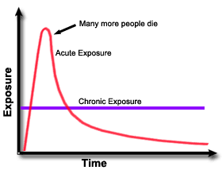
EXPOSURES
ACUTE VS. CHRONIC

Slide 15

TEST YOUR KNOWLEDGE

Slide 16
INSTRUCTIONS
Review the photo and think about processes
Identify hazard, routes of exposure, potential effects

Slide 17
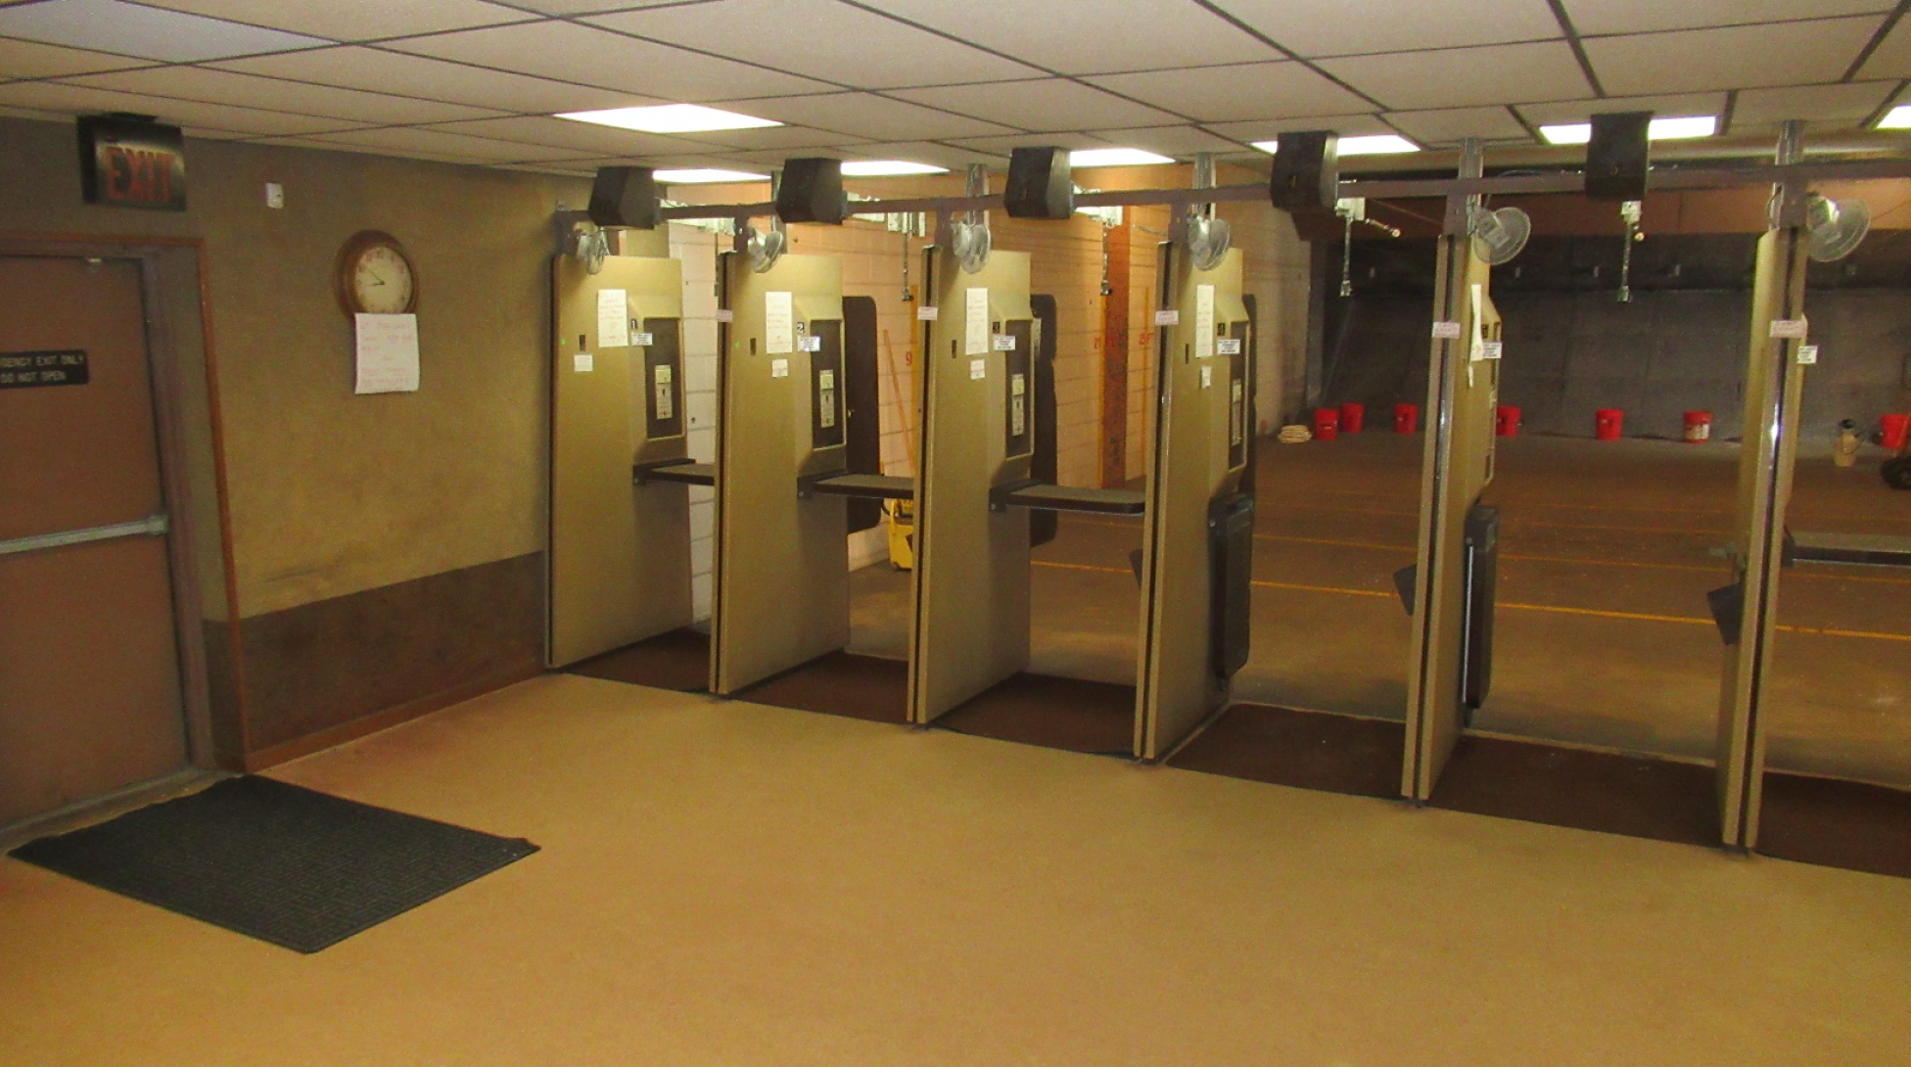
INDOOR SHOOTING RANGE
What are the hazards?

Slide 18
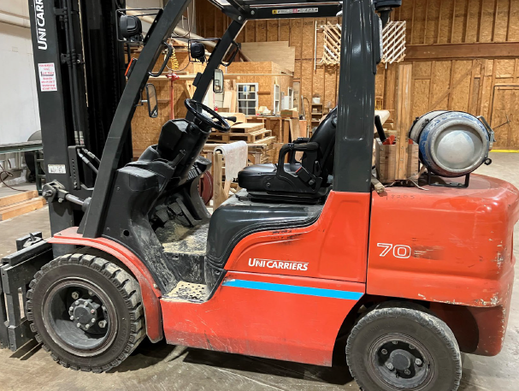
FORKLIFTS
What are the hazards?

Slide 19
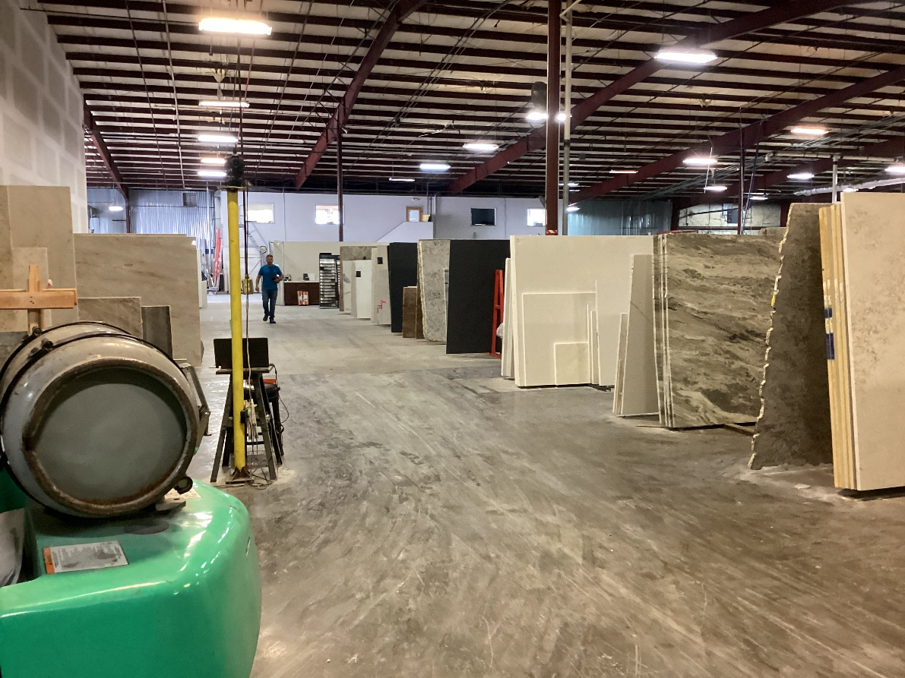
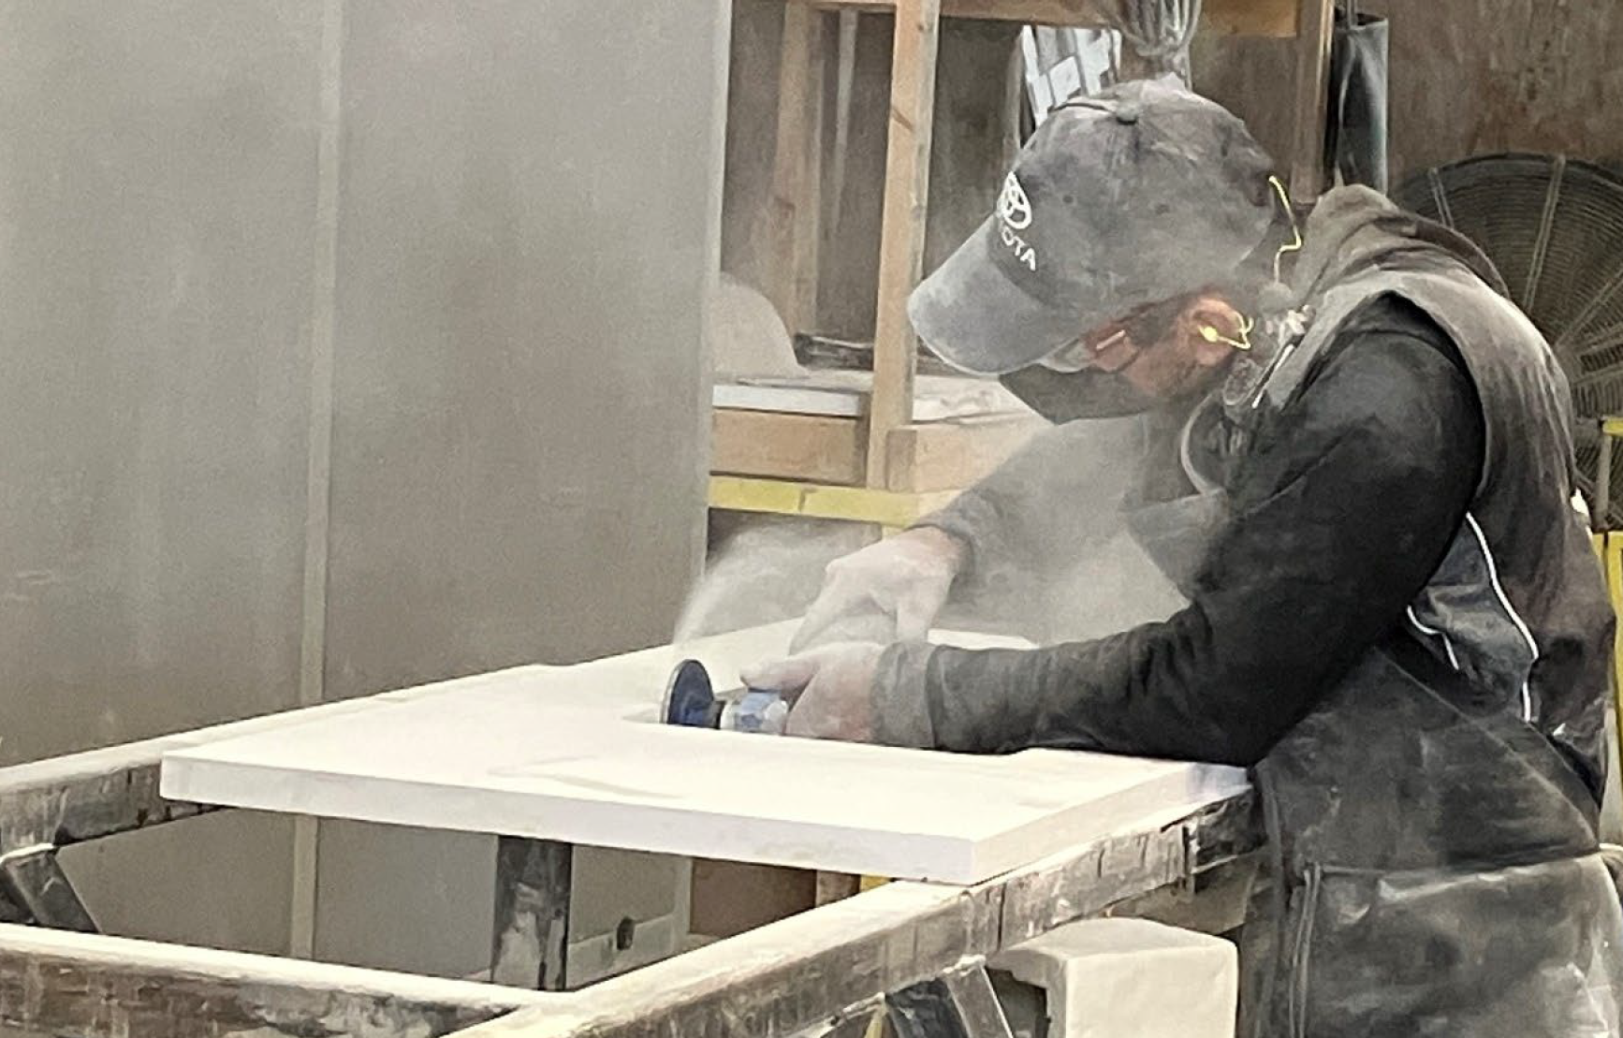
STONE COUNTERTOP MANUFACTURE
What are the hazards?

Slide 20
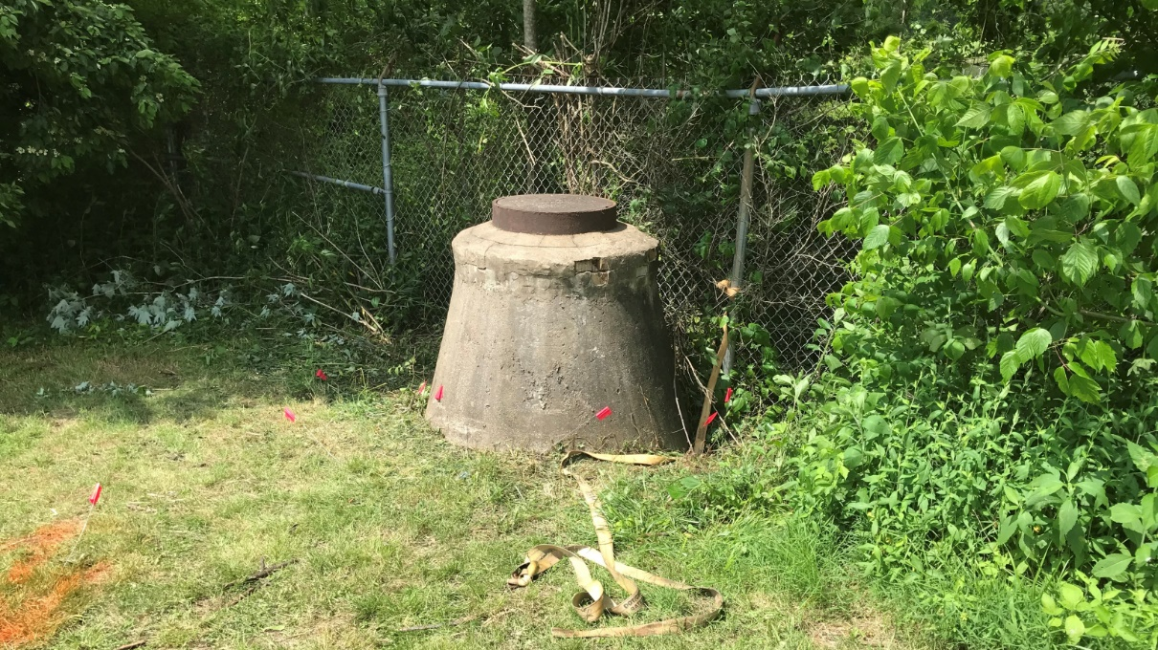
SEWER WORK
What are the hazards?

Slide 21
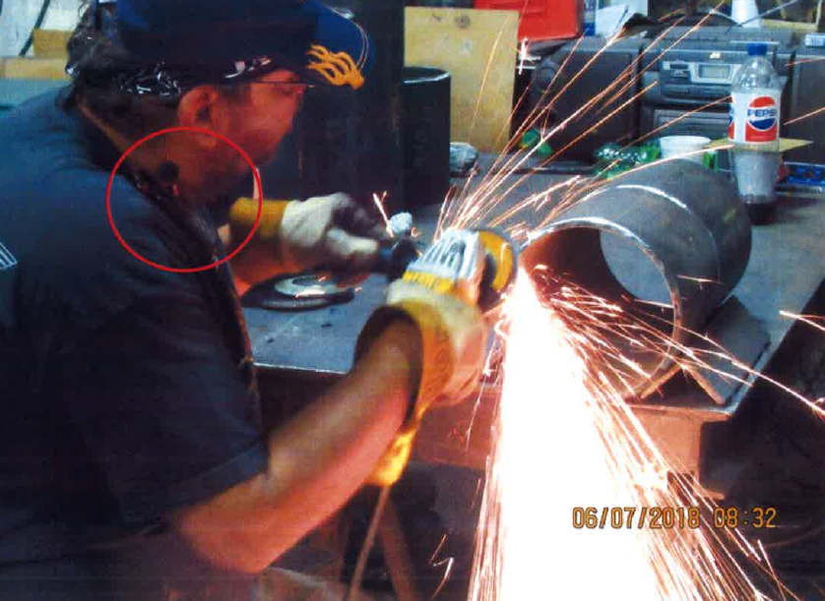
WELDING/FABRICATION - PIPE FITTER
What are the hazards?

Slide 22
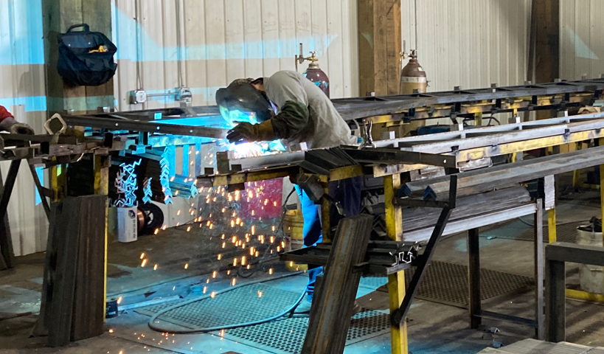
WELDING/FABRICATION - WELDER
What are the hazards?

Slide 23
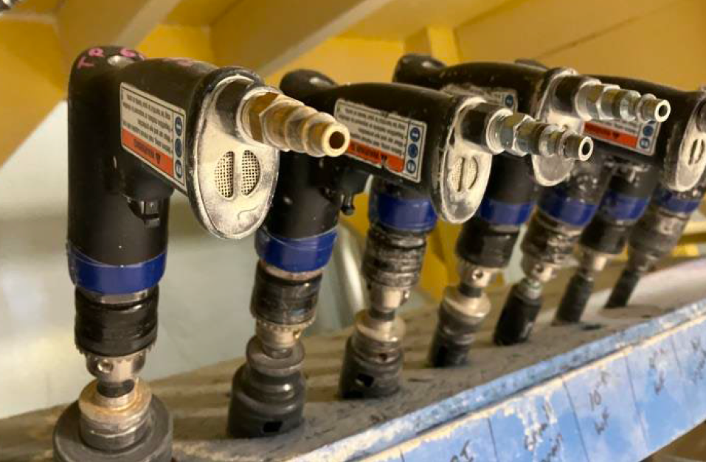
USING PNEUMATIC TOOLS
What are the hazards?

Slide 24

OTHER HAZARDS TO RECOGNIZE

Slide 25


BIOLOGICAL HAZARDS
Bloodborne Pathogens
HIV / AIDS
Hepatitis B
Hepatitis C

Slide 26

BIOLOGICAL HAZARDS
Legionella
Genus of gram-negative bacteria
Known to cause Legionellosis / Legionnaires’ disease

Slide 27

BIOLOGICAL HAZARDS
Vermin Bites / Stings

Slide 28
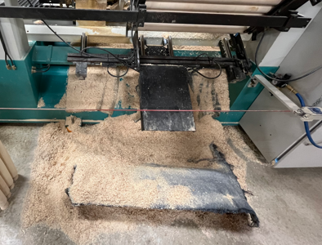
COMBUSTIBLE DUST

Slide 29

EVALUATION OF HAZARDS

Slide 30
HAZARD INDENTIFICATION
① Recognize/Identify potential source of harm
Hazardous chemicals - ANALYSIS
Unsafety work procedures
Dangerous equipment
② Risk Assessment
Job Hazard Assessment
Probability: the likelihood of harm occurring
Consequence: the severity of that harm

Slide 31


CHEMICAL HAZARD EVALUATION
CHEMICAL LOOK-UP / SAMPLING METHODS
①
②
OSHA
Chemical Database
NIOSH
Pocket Guide to Chemical Hazards
③
Analytical Lab of Choice
Eurofins
SGS Galson
Pace Analytical

Slide 32
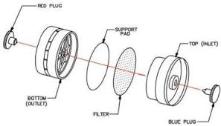
EQUIPMENT REVIEW

Slide 33
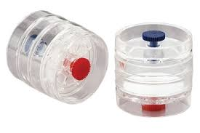
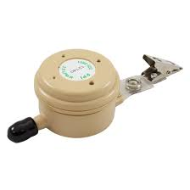
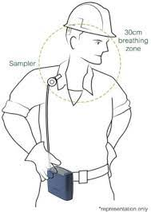

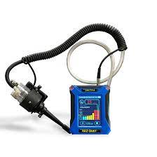
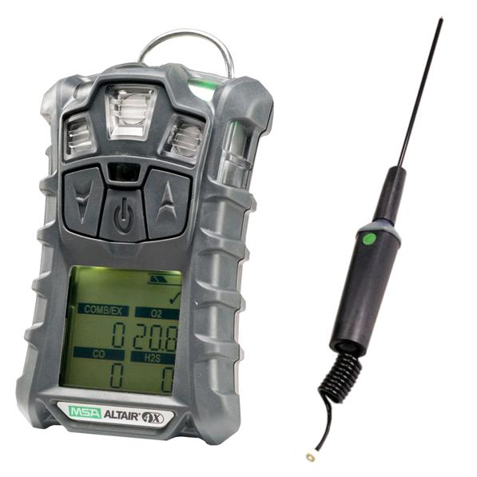

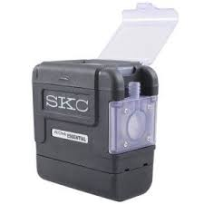

PERSONAL
AIR MONITORING EQUIPMENT
Direct | TWA (PEL, STEL, C¹)
 | Active | Passive
¹PEL – Permissible Exposure Limit
STEL – Short-Term Exposure Limit
C - Ceiling
*Valuable tools for detecting and measuring real-time worker exposure to gases, vapors, aerosols, and fine particulates suspended in air.
*the use of electronic instruments to actively measure concentrations of air contaminants such as gases, vapors, fine particulates, or oxygen levels in an employee’s breathing zone² providing data to guide actions and ensure compliance with exposure limits.
*A method of collecting airborne contaminants without the use of pumps or powered devices.
² Breathing zone: in a hemisphere forward of the shoulders with a radius of 6 to 9 inches.

Slide 34

HAZARD CONTROL

Slide 35
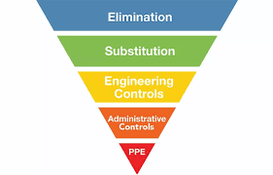
HIERARCHY OF CONTROLS
Water-based paints
Non- / less- toxic alternatives
Ventilations
Guards/Shields
Training
Signs

Slide 36


ELIMINATION
*Most effective
Eliminate CO hazard by replacing propane fueled forklift with electric forklift

Slide 37
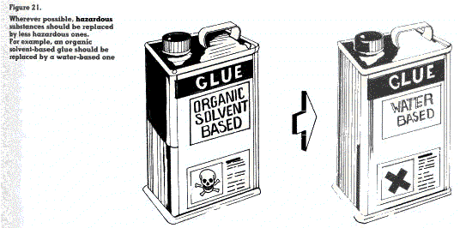
SUBSTITUTION

Slide 38
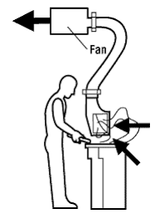

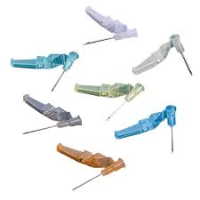
ENGINEERING CONTROLS
Ventilation – Local Exhaust Ventilation (LEV)
Enclosure / guarding
Safer needles – retractable needles, one hand recap needles

Slide 39



ADMINISTRATIVE CONTROLS
Job rotation (if permitted)
Training
Signs
Policies & Procedures
Scope of Practice (SOP)

Slide 40

PERSONAL PROTECTIVE EQUIPMENT
*Least effective

Slide 41
PPE- THE LAST LINE OF DEFENSE
TDLWD Rule 0800-01-01-.07(2)(b)1:Employees were exposed to an airborne concentration of PNOR-respirable dust listed in Table Z-1-A in excess of 5 mg/m³ as an 8-hour Time Weighted Average concentration.
TDLWD Rule 0800-01-01-.07(2)(d): Feasible administrative or engineering controls were not determined and implemented to achieve compliance with the limits prescribed in 0800-01-01-.07(2)(b) and (c).

Slide 42
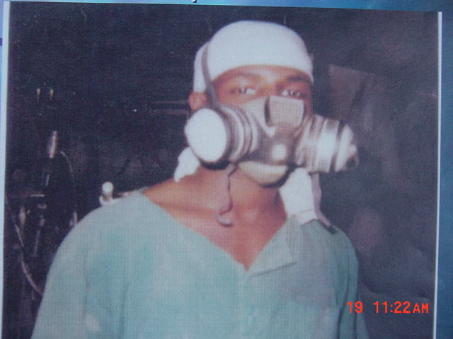
TRAINING IS CRITICAL
Do you think I was properly trained to wear this respirator?

Slide 43
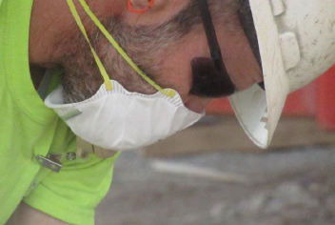
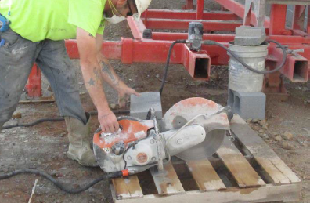
TRAINING IS CRITICAL
Do you think I was properly trained to wear this respirator?

Slide 44

TOSHA STANDARDS

Slide 45
HEALTH COMPLIANCE VIOLATIONS
Between 2020-2025
  6,313 violations identified
  $3,790,875 in penalties
General topics addressed
  Hazard evaluation
  Engineering controls
  Personal protective equipment
  Training on hazards

Slide 46
TOSHA Z-1-A
IMPORTANT TERMS
PEL - Permissible Exposure Limit
  Eight-hour Time Weighted Average
STEL- Short Term Exposure Limit
  5 or15 minute time weighted average
Ceiling
  Cannot reach or exceed
Skin Designation

Slide 47
OSHA
EXPANDED HEALTH STANDARDS
1910.1000 | Air Contaminants
1910.1001 | Asbestos
1910.1003-1016 | 13 Carcinogens
1910.1017 | Vinyl Chloride
1910.1018 | Inorganic Arsenic
1910.1024 | Beryllium
1910.1025 | Lead
1910.1026 | Chromium (IV)
1910.1027 | Cadmium
1910.1028 | Benzene
1910.1029 | Coke Oven Emissions
1910.1030 | Bloodborne Pathogens
1910.1043 | Cotton Dust
1910.1044 | 1,2-dibromo-3-chloropropane
1910.1045 | Acrylonitrile
1910.1047 | Ethylene Oxide
1910.1048 | Formaldehyde
1910.1050 | Methylenedianiline
1910.1051 | 1,3-Butadiene
1910.1052 | Methylene Chloride
1910.1053 | Respirable Crystalline Silica
1910.1450 | Occupational exposure to hazardous chemicals in laboratories.

Slide 48
EXPANDED STANDARDS
DETAILED REQUIREMENTS
Exposure monitoring to characterize exposures
Methods of compliance
e.g. engineering controls, work practice controls, compliance programs, etc.
Respiratory protection & protective work clothing
Hygiene facilities
Medical surveillance
Employee information & training
Recordkeeping

Slide 49

COMMON STANDARDS CITED

Slide 50


TOSHA RESOURCES
TOSHA website:
www.tnosha.gov
Area Offices:
Nashville 615-741-2793 or
1-800-249-8510
Memphis 901-543-7259
Jackson 731-423-5640
Knoxville 865-594-6180
Gray 423-854-5158
Chattanooga 423-634-6424
Subscribe to the TOSHA Newsletter

Slide 51

TOSHA RESOURCES
Consultative Services
  (800) 325-9901
  Add more bullets

Slide 52


TOSHA RESOURCES
Training and Education
  Seminar Training Schedule
  Special Emphasis Programs
  Find the Hazard
  Required Training
  Request a TOSHA Speaker

Slide 53
OTHER RESOURCES
OSHA.GOV
National Institute for Occupational Safety and Health (NIOSH) : cdc.gov/niosh
ADD OTHER TOPIC RELEVANT RESOURCES

Slide 54



FOLLOW US ON
TOSHA - @TennesseeOSHA
TN Dept of Labor & Workforce - @Jobs4_TN

Slide 55

QUESTIONS?

Slide 56
THANK YOU

