Slide 1
A Safe Investment
Advance Your Safety Team with ASSP

Slide 2
Who We Are
For more than 100 years, ASSP has been at the forefront of helping occupational safety and health (OSH) professionals protect people and property.
ASSP is a global association for occupational safety and health professionals.

Slide 3
Membership Benefits
Community
Education
Standards
Advocacy

Slide 4
Community
Reach the highest level of performance by connecting with great resources and great people

Slide 5
Our Community
ASSP is where occupational safety and health professionals find a vibrant community:
Over 39,000 members
150 chapters across nine U.S. and global regions
All industries and diverse voices across age, gender, race and ethnicity
22 member communities, which include common interest groups and practice specialties
Exclusive online community
62% of members with credentials hold a CSP certification

Slide 6
Networking
Community and Networking Opportunities
Meet local OSH professionals through monthly chapter meetings
Practice specialties offer the unique opportunity to network among OSH professionals in your industry
Common interest groups represent different groups across age, gender, race and ethnicity to support diversity in the OSH profession
Our exclusive online member community connects you with great resources and great people to help you grow professionally and engage with colleagues on a global scale

Slide 7
Education
Top-quality safety training and education that you can immediately put into practice

Slide 8
Education That Counts
Safety Certifications Matter
Gain a competitive advantage with our Cert Prep courses
100% course guarantee
ASP, CSP, CHST, OHST, SMS Prep Courses and Math Review
Master a Safety Practice Area
Enhance your skill with our 6 ASSP certificate programs
Certificate in Safety Management, Executive Program in Safety Management, Global Safety Management, Managed Fall Protection, ISO 45001, Risk Assessment
Earn Continuing Education Credits to Stay Relevant
Contribute content to Professional Safety Journal
We offer:
A robust education calendar
In-person and virtual learning opportunities
Local chapter engagement

Slide 9
Education You Can Access
Learn about the latest issues in safety at your convenience
Live webinars
Virtual courses
On-demand sessions
Virtual symposia
Podcasts
New members receive one free educational webinar ($115 value)

Slide 10
Stay Current on Relevant Issues
Professional Safety Journal
#1 ranked OSH Journal
Monthly and archived online
Topics include: Best practices, Safety Management, Health & Wellness, Leadership, Rules & Regulations, Standards, Industry Notes, and New Product Innovations
Practical Content
Society update
Monthly newsletter and EHS Works blog
Business of Safety Resource Center

Slide 11
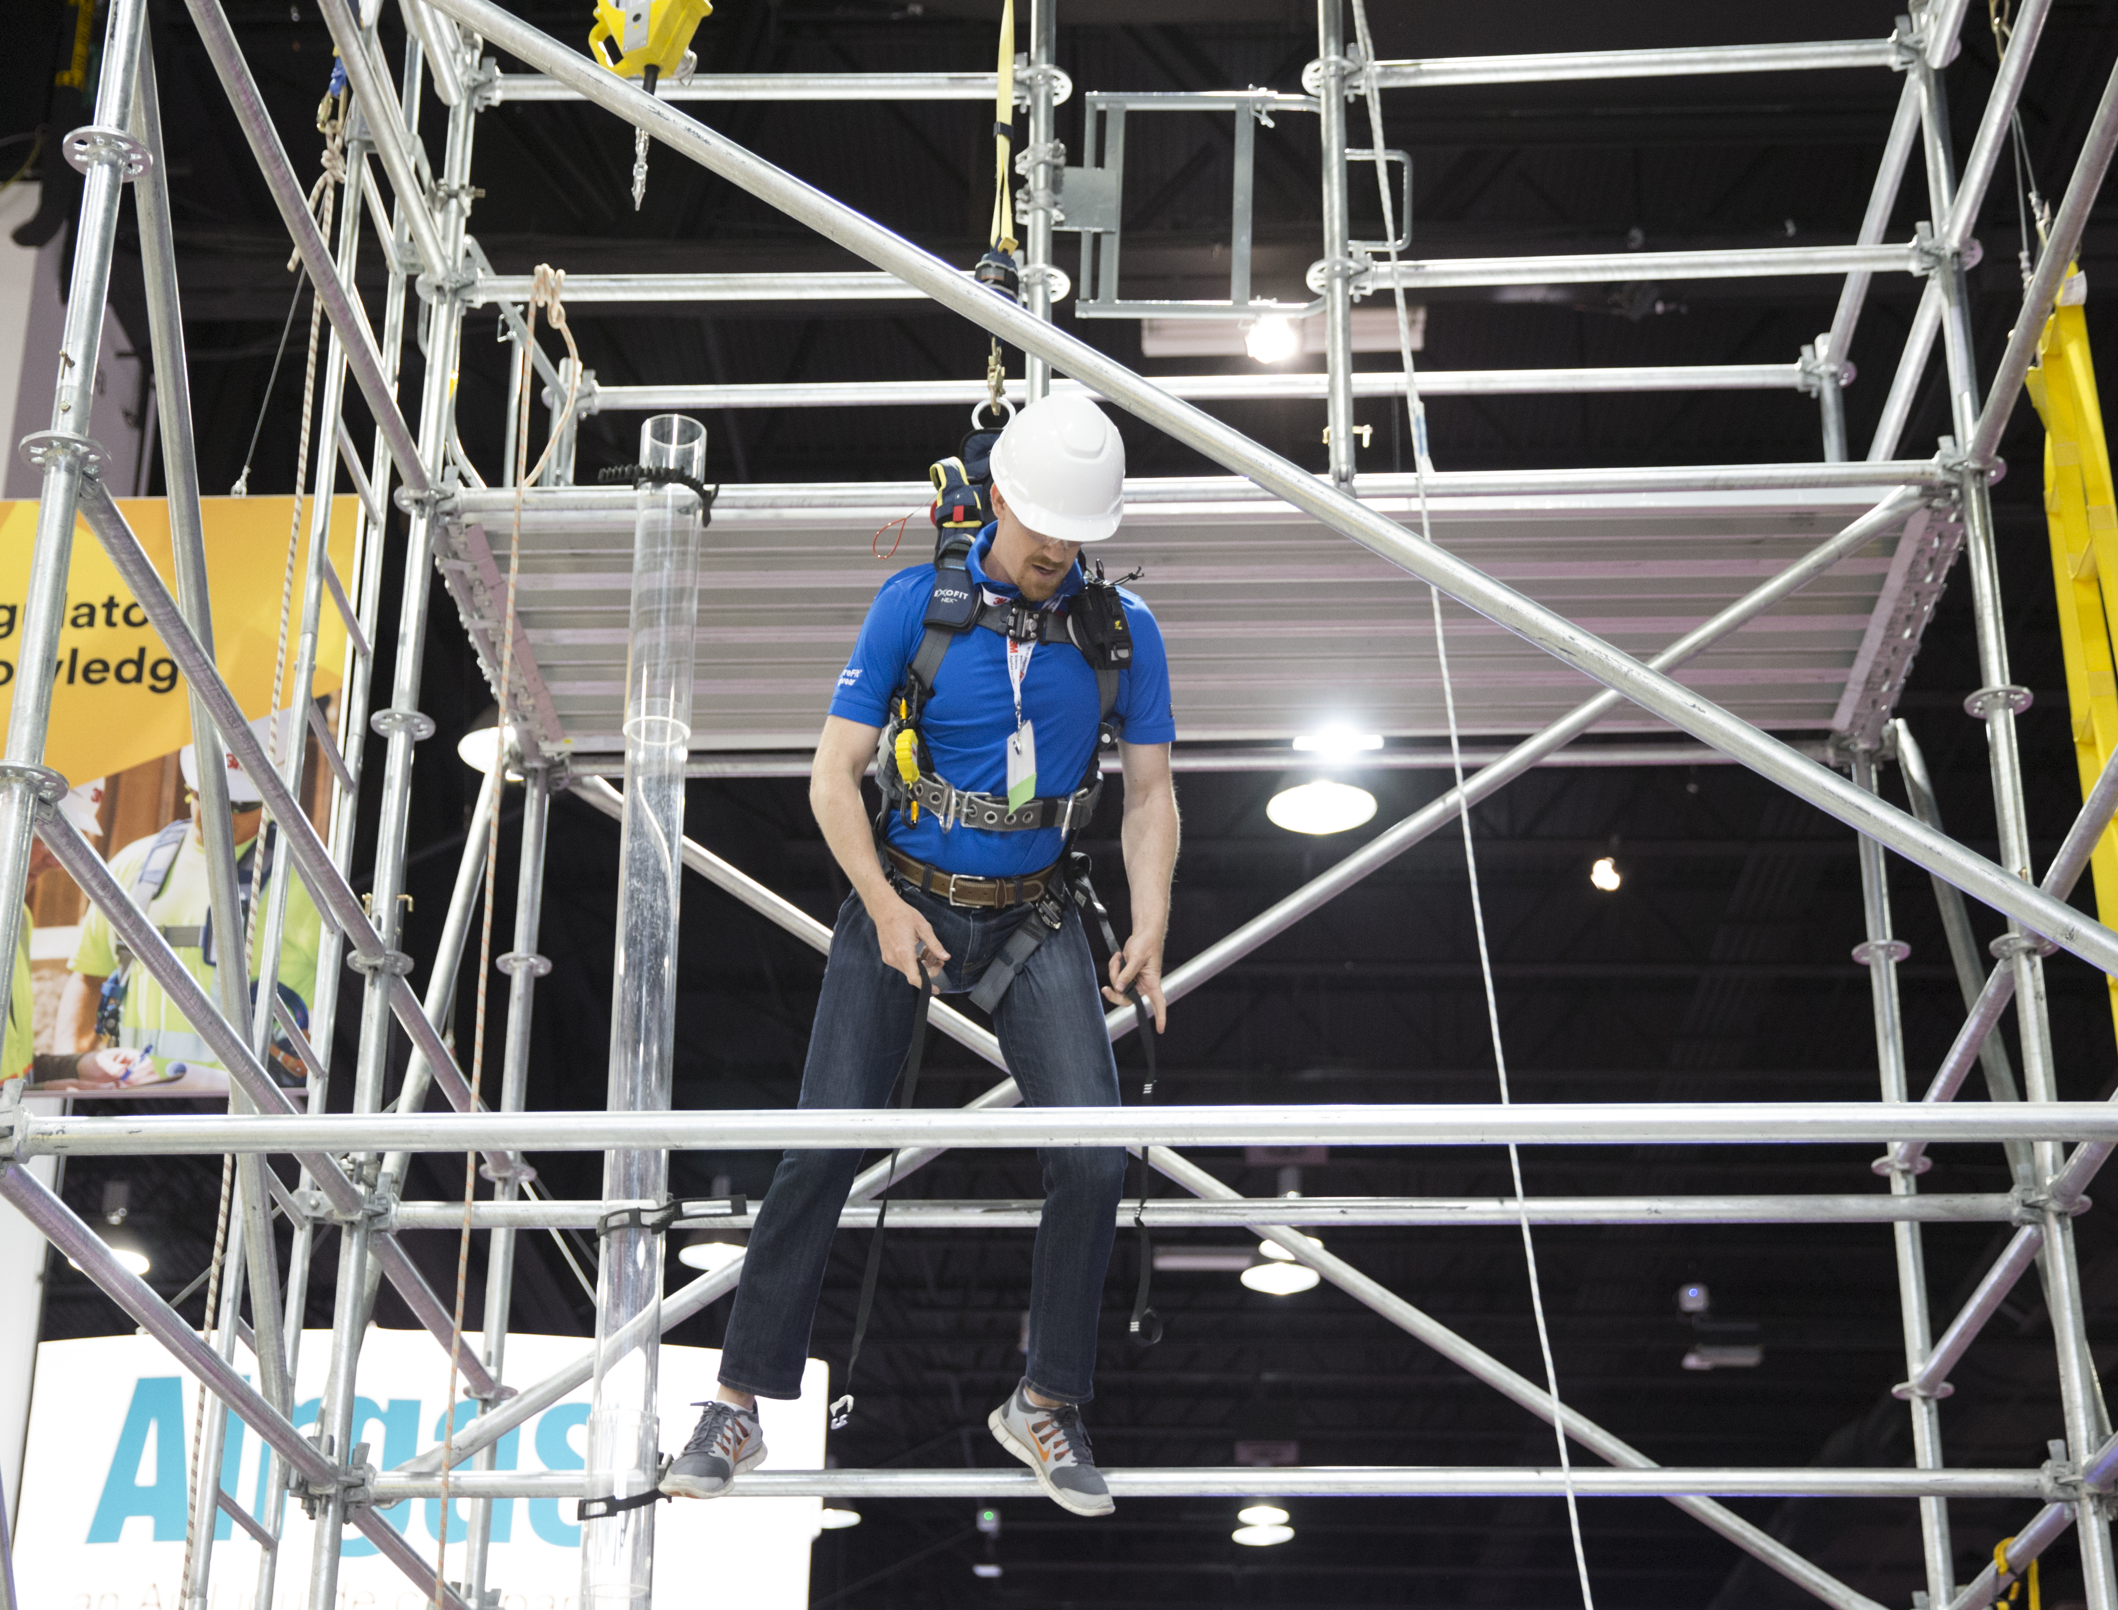
Attend Top Industry Events
ASSP Annual Professional Development Conference & Exposition
More than 240 concurrent sessions focused on 20 different subject areas
300+ speakers and 600+ exhibitors presenting the latest products, technology and techniques
Engage with more than 5,000 attendees and industry experts
SafetyFOCUS
Choose from 100+ courses across 8 areas of focus
Participate in full-day courses across an entire week
Network with 1,200+ OSH professionals
Earn up to 5.6 CEUs
Members save on Event Registration

Slide 12
Standards
Promote safe work environments

Slide 13
Standards
ASSP is a leader in the evolution of voluntary occupational safety and health standards that reflect recognized best practices, both in the U. S. and internationally.
As Secretariat for multiple projects, we organize the standards development committees
We serve as the administrator of the U.S. technical advisory groups for ISO 45001 and ISO 31000
Our Certification and Accreditation Institute certifies companies to an established standard

Slide 14
Standards Topics
ASSP Standards promote recognized best practices that prevent worker injuries, illnesses and fatalities. Our standards portfolio includes:
Aerial Work Platforms (A92)
Construction & Demolition Operations (A10)
Fall Protection & Fall Restraint (Z395)
Machine Guarding (B11)
Personal Protective Equipment
Risk Management & Risk Assessment (Z690, ISO 31000)
OSH Management (Z10, ISO 45001)
OSH Training (Z490.1)
Walking/Working Surfaces
Ventilation Systems (Z9)
Confined Spaces (Z117.1)
Fleet Motor Vehicles (Z15)
Prevention Through Design (Z590.3)
Hydrogen Sulfide Training (Z390.1)
LOTO and Alternative Methods (Z244.1)
Active Shooter Preparedness (Z590.5)

Slide 15
Advocacy
Elevate the value of the OSH profession

Slide 16
Advocacy
ASSP strives to uphold and elevate the value of the safety profession through innovation, thought leadership, and objective, data-driven, solutions-based safety and health practices
Latest news & information in OSH Governmental regulations
State Legislative and Regularity Activity Reports
Opportunity to get your voice involved in the Governmental Affairs Committee in the

Slide 17
What ASSP Can Do For Your Organization
Drive business performance through knowledge
Reduce the risk of costly fines for non-compliance
Deliver tools, resources, and examples to address specific business challenges
Bridge the gap between Safety and the bottom line
Strengthen the skill set of your Safety team
Deliver research and data analysis to help show the value & need for Safety Management

Slide 18
Join ASSP
Start Utilizing the Power of Member Benefits Now
With the money you save, your membership will pay for itself
LEARN MORE

